Slide 1


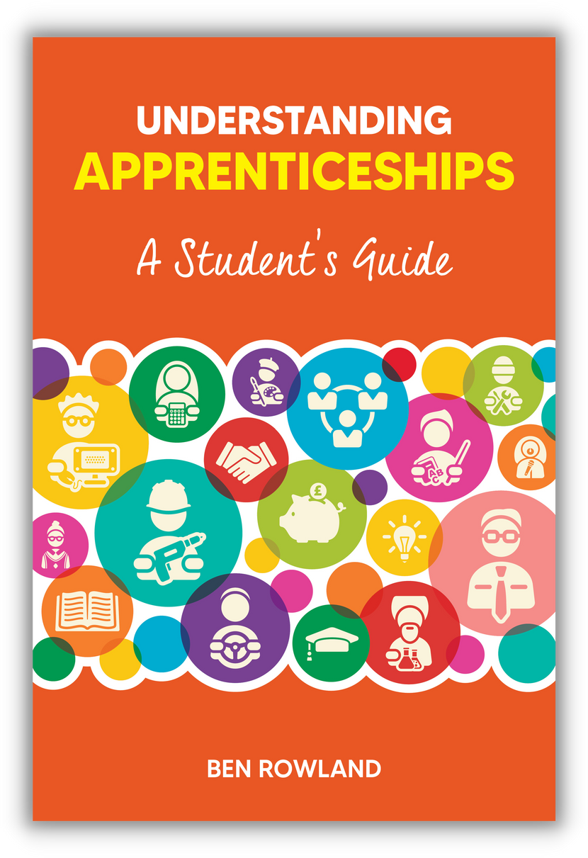
TEACHER COPY
Supplementary materials
for students
UNDERSTANDING APPRENTICESHIPS
A Student’s Guide
Lesson 4: Weighing Up Your Options

Slide 2
INTRODUCTION FOR TEACHERS
This is the fourth of four lesson plans for teachers to use with students in Years 11 to 13 to accompany the book Understanding Apprenticeships: A Student’s Guide, written by Ben Rowland and published by Trotman (https://amzn.eu/d/ixvRrGq).
This lesson is called Weighing Up Your Options. It covers:
  What your main options are
  The kind of things to think about when weighing up these options
  Some suggested approaches to going about comparing options
It is intended to initiate purposeful conversations and self-reflection that will help young people understand the apprenticeship option better as they compare it to other post-school options.
© Ben Rowland 2023

Slide 3

SUGGESTED TIME: 1-2 MINUTES
WEIGHING UP YOUR OPTIONS – OBJECTIVES
Help you understand what your main options are
What you could be including in your deliberations
How to go about evaluating and comparing your options
© Ben Rowland 2023

Slide 4
SUGGESTED TIME: 6-7 MINUTES
Begin with an open discussion about what your students are thinking about doing – the key is to avoid judgement or getting people to ‘justify’ their choice. Focus on variety and what they have seen that has led them to that current choice.
QUESTION FOR DISCUSSION:
WHAT ARE YOUR MAIN OPTIONS?
© Ben Rowland 2023

Slide 5

SUGGESTED TIME: 2-3 MINUTES
WHAT ARE YOUR MAIN OPTIONS?
Going to university
Walk them through the main options.
There is more detailed information in Chapter 4 of Understanding Apprenticeships: A Student’s Guide.
Doing an apprenticeship
Taking a year (or two) out
Getting a regular job
Doing further education (other courses, not an apprenticeship or degree)
© Ben Rowland 2023

Slide 6
SUGGESTED TIME: 11-13 MINUTES
The most important thing is to ensure that students understand that whatever the pros and cons they identify, none of them are guaranteed (i.e. not every apprenticeship is brilliant, not every degree will lead to a well paid job) and (in most cases) the particular option is not the only way to achieve that.
ACTIVITY!
QUESTION: WHAT ARE THE PROS AND CONS OF EACH?
1. DISCUSS IN SMALL GROUPS
LOOK AT ONE OF THE OPTIONS FROM THE PREVIOUS SLIDE AND IDENTIFY THE PROS AND CONS FOR THAT OPTION
SUGGESTED TIME:
5 MINUTES
SUGGESTED TIME:
6-8 MINUTES
2. SHARE BACK WITH THE GROUP
© Ben Rowland 2023

Slide 7
Kick off this section with a short discussion on how they have gone about identifying and comparing their post-school options already.
Then move them onto the next slide…
SUGGESTED TIME: 11-12 MINUTES
HOW CAN YOU COMPARE THESE OPTIONS?
WITH SO MANY OPTIONS – AND WITH EACH ONE HAVING MANY COMBINATIONS AND VARIATIONS – IT IS NOT EASY TO COMPARE OPTIONS
How do you go about it?
© Ben Rowland 2023

Slide 8
SUGGESTED TIME: 10-15 MINUTES
Take 10-15 minutes to allow students to work their way through the first 3 tasks, and to identify what they are going to use for their research (task 4) and who they are going to get advice from (task 5) on the next slide (these two tasks are to be done independently). You may wish to set up follow ups with those who are interested.
ACTIVITY!
HOW CAN YOU COMPARE THESE OPTIONS?
1. NOTE DOWN YOUR INITIAL THOUGHTS ON WHAT YOU THINK YOU WANT TO DO AFTER SCHOOL
Explore your reasons, separating out those which are about what other people think (like your parents or teachers) from those which are what you think.
2. LOOK AT THE FINANCES: WHAT IS THE TRUE COST OF EACH OF YOUR OPTIONS? HOW DO YOU FEEL ABOUT DEBT?
3. LOOK AT THE TIMING: HOW READY ARE YOU FOR EACH OPTION? HOW DO YOU FEEL ABOUT THE LENGTH OF EACH OPTION?
© Ben Rowland 2023

Slide 9
ACTIVITY!
AFTER THE LESSON...
4. DO YOUR RESEARCH: ONLINE, GUIDANCE BOOKS (E.G. UNDERSTANDING APPRENTICESHIPS: A STUDENT’S GUIDE, WRITTEN BY BEN ROWLAND)
5. GET ADVICE: FROM YOUR CAREERS ADVISORS, FRIENDS OF THE FAMILY, OLDER SIBLINGS/COUSINS AND PEOPLE IN YOUR COMMUNITY
6. HAVING DONE ALL OF THE ABOVE – BUT ONLY WHEN YOU HAVE DONE ALL OF THE ABOVE – TRUST YOUR INSTINCT!
© Ben Rowland 2023

