Slide 1


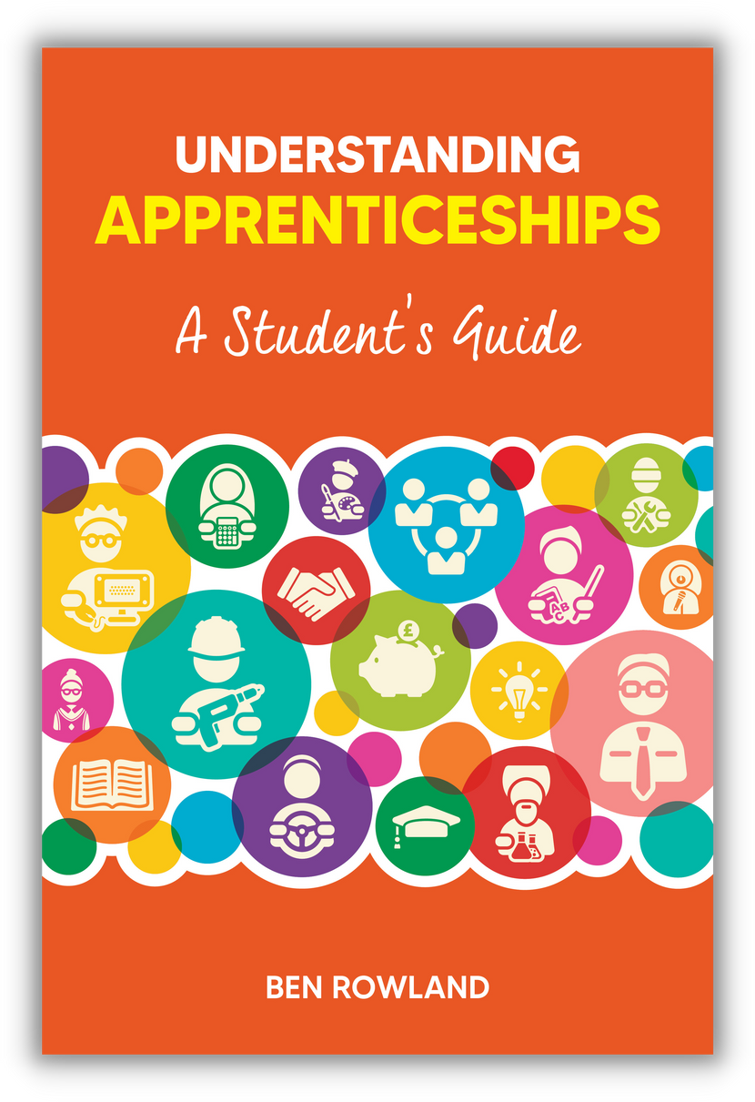
TEACHER COPY
Supplementary materials
for students
UNDERSTANDING APPRENTICESHIPS
A Student’s Guide
Lesson 2: What an Apprenticeship Is

Slide 2
INTRODUCTION FOR TEACHERS
This is the second of four lesson plans for teachers to use with students in Years 11 to 13 to accompany the book Understanding Apprenticeships: A Student’s Guide, written by Ben Rowland and published by Trotman (https://amzn.eu/d/2CToeXT).
This lesson is called What An Apprenticeship Is. It covers:
  What an apprenticeship is
  What makes apprenticeships a potentially attractive option
  How an apprenticeship works
  Things to be aware of
It is intended to initiate purposeful conversations and self-reflection that will help young people understand the apprenticeship option better as they compare it to other post-school options.

Slide 3

SUGGESTED TIME: 1-2 MINUTES
WHAT AN APPRENTICESHIP IS – OBJECTIVES
Help you understand what an apprenticeship is and how it works
Understand your potential pros and cons
© Ben Rowland 2023

Slide 4
SUGGESTED TIME: 4-5 MINUTES
ACTIVITY - QUIZ
WHICH OF THESE COMPANIES HAVE YOU HEARD OF AND WHAT DO THEY DO? WHICH ONES DO NOT OFFER APPRENTICESHIPS?
  PwC
  Deliotte
  EY
  KPMG
  IBM
  Unilever
  BAE Systems
  BT
  Pinsent Masons
  Jaguar Land Rover
  Goldman Sachs
  Amazon
  Google
  Accenture
  GSK
  UK Government
  NHS
Suggested approach: Start by asking students to identify the firms they know and what they do/produce.
Then ask them to say which ones offer apprenticeships and which ones don’t (either on their own, in pairs or as a whole group discussion).
© Ben Rowland 2023
Answer: All of them do.
There's a good list here: https://www.ratemyapprenticeship.co.uk/best-apprenticeship-employers
And here: https://www.topapprenticeshipemployers.co.uk/Top100AE22.pdf
Information on what each company does can be found on the following slide.

Slide 5
WHAT DO THE COMPANIES DO?
PwC – accountancy, audit, tax and business advice to major corporations
Deloitte – accountancy, audit, tax and business advice to major corporations
EY – accountancy, audit, tax and business advice to major corporations
KPMG – accountancy, audit, tax and business advice to major corporations
IBM – business-focused computer software and data services
Unilever – stuff you buy in the supermarket! From shampoo brands to Marmite and everything in between
BAE Systems – military aircraft and other vehicles, weapons systems (i.e. guns, bombs and missiles)
BT – telecommunications (internet, phones, etc.)
Pinsent Masons – big legal firm of solicitors, advising other big companies on their legal positions and options
Jaguar Land Rover – makes cars
Goldman Sachs – big investment bank, helping countries and corporations use their money well
Amazon – online retail giant (that actually makes most of its money from renting out computer servers!)
Google – online search engine and other useful tools (e.g. Google Maps)
Accenture – big IT firm that helps companies design, develop and implement big IT solutions
GSK – researches and develops medical drugs for people who are ill
UK Government – runs the country (sometimes…)
NHS – the 500 or so bodies that make up the UK’s free-to-use health system
© Ben Rowland 2023

Slide 6

SUGGESTED TIME: 4-5 MINUTES
Suggestion: ask students about something they’ve learned to do recently.
You could use an example from day-to-day life, e.g. learning how to ride a bike, learning how to bake a cake, or it could be a new skill learnt at school or in a job.
Chapter 2.1 of Understanding Apprenticeships: A Student’s Guide gives a full explanation of learning how to bake a cake.
HOW DO YOU LEARN HOW TO DO SOMETHING?
Being told about how it all works
Having a go yourself
Researching and reading up on the theory
With someone on hand to show you and help you
Writing assignments to prove what you know
With the opportunity to ask questions as you go
This is what an apprenticeship is – but instead of being for a specific skill, it’s for a whole job
Then present these two ways of learning and ask students to talk about the pros and cons of the different ways of learning, including the difference between academic learning and practical learning.
© Ben Rowland 2023

Slide 7
Suggested activity: ask students to think about/discuss in pairs what they think of as an apprenticeship.
Share as a group.
Then take them to the next slide.
Compare and contrast what they say with what’s on the slide and use that to stimulate discussion
SUGGESTED TIME: 2-3 MINUTES
WHAT IS AN APPRENTICESHIP?
© Ben Rowland 2023

Slide 8
SUGGESTED TIME: 3-4 MINUTES
WHAT IS AN APPRENTICESHIP?
A REAL JOB
A REAL QUALIFICATION
ACCELERATED LEARNING
  Where you get paid
  Where you are hired – and can be fired
  What you do matters (to someone!)
  There is study as well – all related to the occupation you are in (around 6 hours per week)
  Formally assessed at End Point Assessment
  A ‘protected’ (i.e. fully official) qualification, regulated by Government
  Study that you can apply on the job and/or questions about your job that you can address in your study
  Permission as an apprentice to ask questions
  People looking out for your development
It is the combination of the job and qualification where lots of the magic of apprenticeships happen – using one to stimulate the other, and vice versa.
It is important that they understand that an apprenticeship is not a ‘place’ on a course.
There is a real employer spending their money on their wages.
Turning up and working hard isn’t optional!
© Ben Rowland 2023
‘Protected’ means no organisation can say they are offering an apprenticeship unless it is an official government one (so like a degree).
Apprenticeships are overseen by the Institute for Apprenticeships and Technical Education.

Slide 9
Suggested activity: ask students to think about/discuss in pairs what they think the pros and cons of an apprenticeship might be.
Share as a group.
Then take them to the next slide.
Compare and contrast what they say with what’s on the slide and use that to stimulate discussion
SUGGESTED TIME: 2-3 MINUTES
THE PROS AND CONS
© Ben Rowland 2023

Slide 10
SUGGESTED TIME: 3-4 MINUTES
THE PROS AND CONS
POSSIBLE PROS
POSSIBLE CONS
  Earn money
  Get a qualification
  No debt
  A three year head start v. those going to uni
  Structure and support
  Some include a degree (for free)
  Daunting to be in ‘the real world’: higher ‘stakes’ than continuing full-time education
  Quality depends on the employer and line manager
  Still has formal learning/assessment
  Less likely to have a structured social life/ extra-curricular opportunities
  Other people’s perceptions
© Ben Rowland 2023

