Slide 1

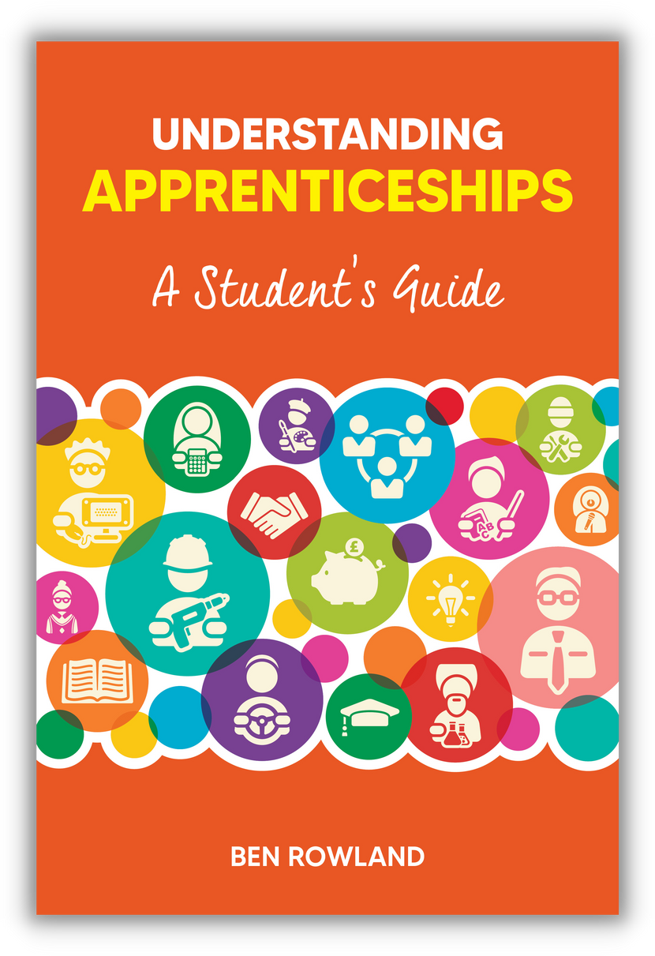
Supplementary materials
for students
UNDERSTANDING APPRENTICESHIPS
A Student’s Guide
Lesson 2: What an Apprenticeship Is

Slide 2
WHAT AN APPRENTICESHIP IS – OBJECTIVES
Help you understand what an apprenticeship is and how it works
Understand your potential pros and cons
© Ben Rowland 2023

Slide 3
ACTIVITY - QUIZ
WHICH OF THESE COMPANIES HAVE YOU HEARD OF AND WHAT DO THEY DO? WHICH ONES DO NOT OFFER APPRENTICESHIPS?
  PwC
  Deliotte
  EY
  KPMG
  IBM
  Unilever
  BAE Systems
  BT
  Pinsent Masons
  Jaguar Land Rover
  Goldman Sachs
  Amazon
  Google
  Accenture
  GSK
  UK Government
  NHS
© Ben Rowland 2023

Slide 4

HOW DO YOU LEARN HOW TO DO SOMETHING?
Being told about how it all works
Having a go yourself
With someone on hand to show you and help you
Researching and reading up on the theory
With the opportunity to ask questions as you go
Writing assignments to prove what you know
This is what an apprenticeship is – but instead of being for a specific skill, it’s for a whole job
© Ben Rowland 2023

Slide 5
WHAT IS AN APPRENTICESHIP?
© Ben Rowland 2023

Slide 6
WHAT IS AN APPRENTICESHIP?
A REAL JOB
A REAL QUALIFICATION
ACCELERATED LEARNING
  Where you get paid
  Where you are hired – and can be fired
  What you do matters (to someone!)
  There is study as well – all related to the occupation you are in (around 6 hours per week)
  Formally assessed at End Point Assessment
  A ‘protected’ (i.e. fully official) qualification, regulated by Government
  Study that you can apply on the job and/or questions about your job that you can address in your study
  Permission as an apprentice to ask questions
  People looking out for your development
© Ben Rowland 2023

Slide 7
THE PROS AND CONS
© Ben Rowland 2023

Slide 8
THE PROS AND CONS
POSSIBLE PROS
POSSIBLE CONS
  Earn money
  Get a qualification
  No debt
  A three year head start vs those going to uni
  Structure and support
  Some include a degree (for free)
  Daunting to be in ‘the real world’: higher ‘stakes’ than continuing full-time education
  Quality depends on the employer and line manager
  Still has formal learning/assessment
  Less likely to have a structured social life/ extra-curricular opportunities
  Other people’s perceptions
© Ben Rowland 2023

